Slide 1
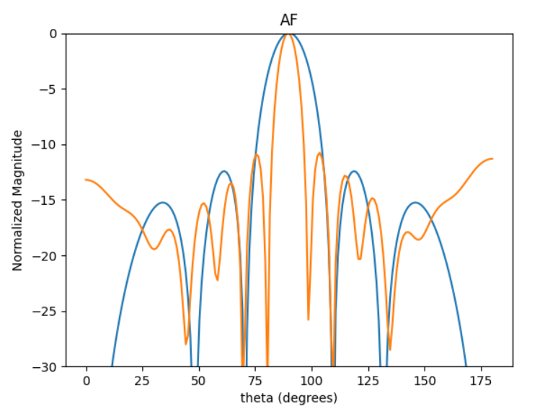
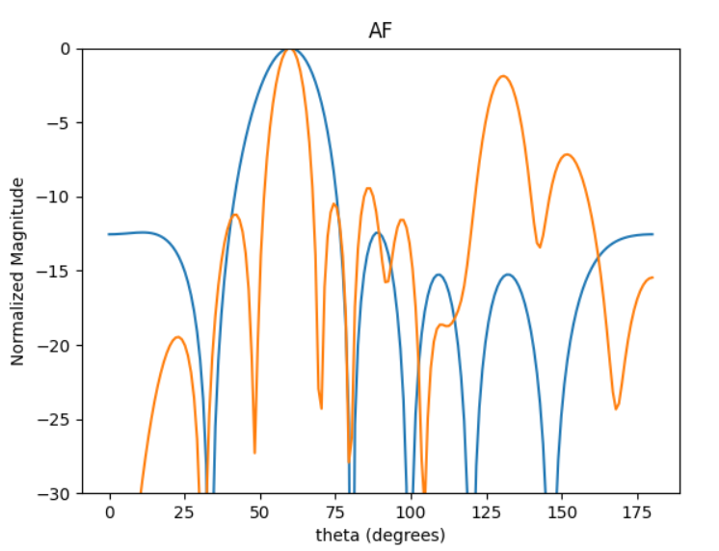
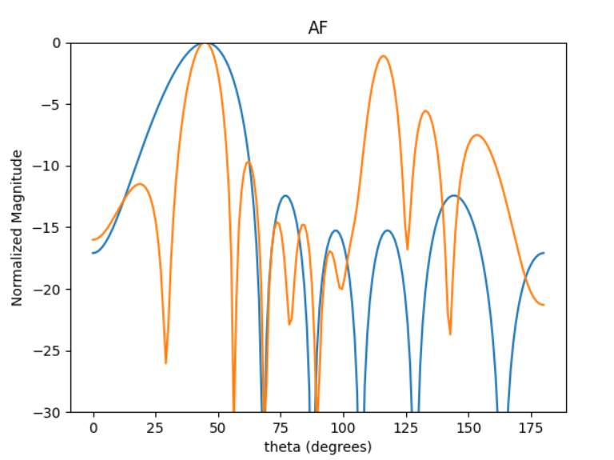
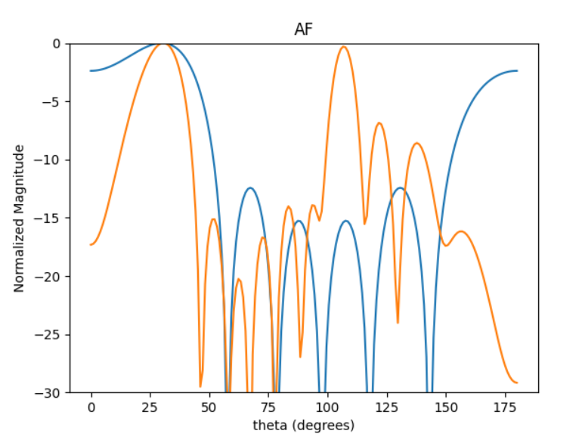
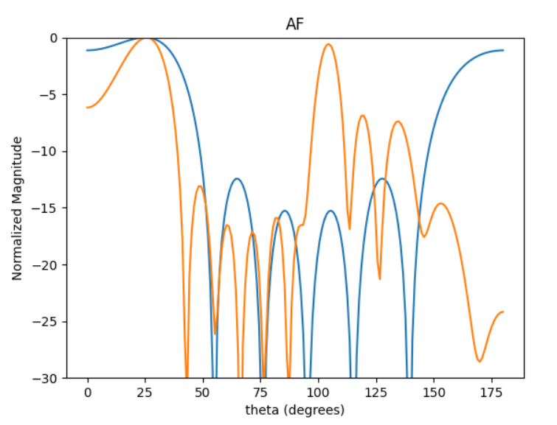
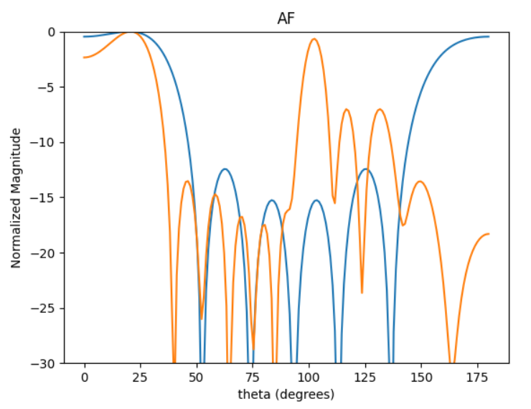
Solution given by literature. Steered using GA.
[0.711, 1.019, 0.868, 0.96, 0.772, 0.747]

Slide 2
Uniformly spaced linear antenna array.
[0.1, 0.1, 0.1, 0.1, 0.1] - [2, 2, 2, 2, 2]
Increments of 0.01

Slide 3
0.5
[c, c, c, c, c]
Best SLL
Best DIR
0.68
0.17
0.86
0.97
Best HPBW

Slide 4
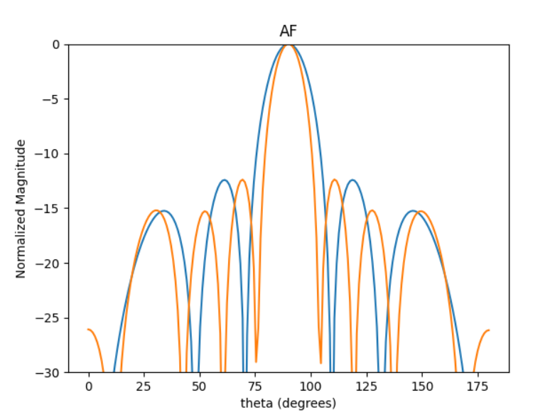
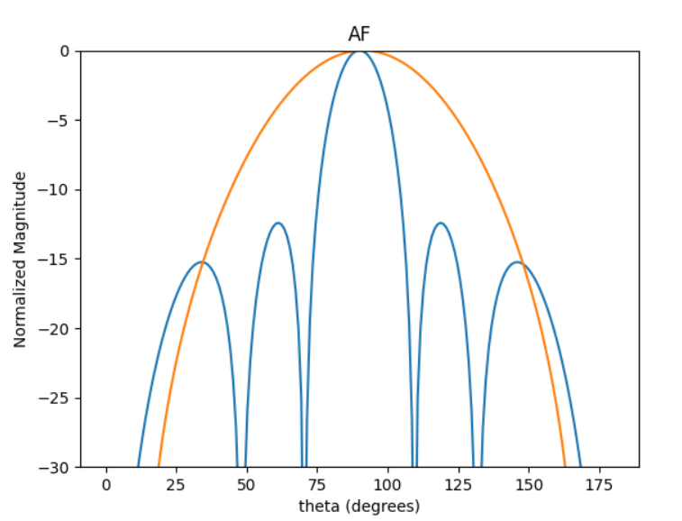
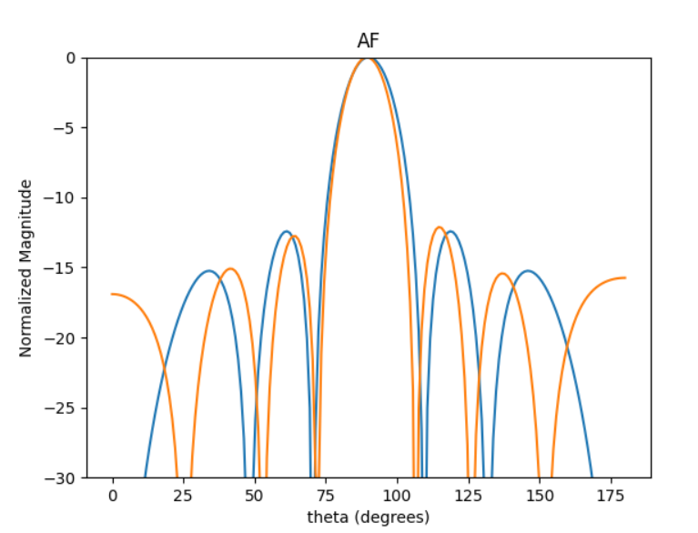
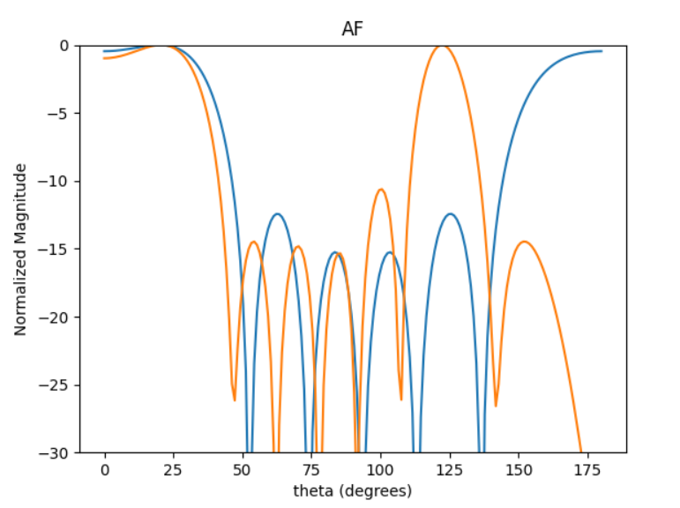
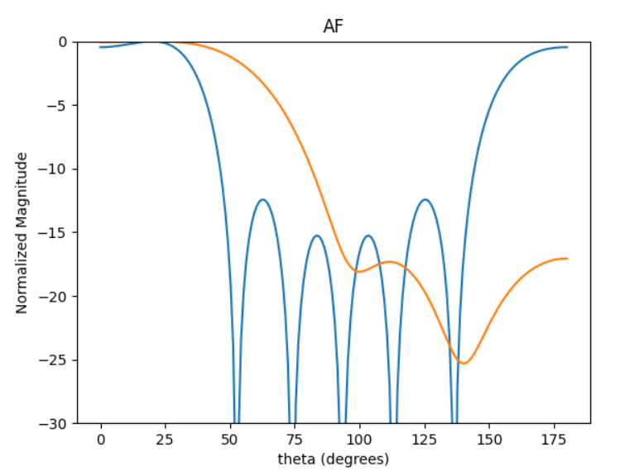
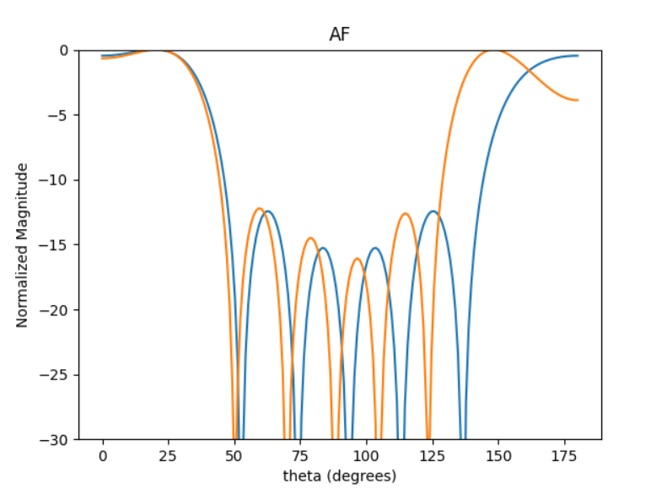
Better HPBW and DIR than 0.5 lambda
Best Directivity:
Best SLL:
[0.68, 0.68, 0.68, 0.68, 0.68]
[0.17, 0.17, 0.17, 0.17, 0.17]
[0.56, 0.56, 0.56, 0.56, 0.56]

Slide 5
Symmetrical linear antenna array.
[0.1, 0.1, 0.1, 0.1, 0.1] - [0.5, 0.5, 0.5, 0.5, 0.5]
Increments of 0.025

Slide 6
[A, B, C, B, A]
[0.1, 0.1, 0.1, 0.1, 0.1]
As C becomes larger more solutions meet the criteria.
Criteria:
At broadside: SLL <-4 and HPBW < 25
At 20DEG: SLL <-3

Slide 7
AVG SPACING

Slide 8
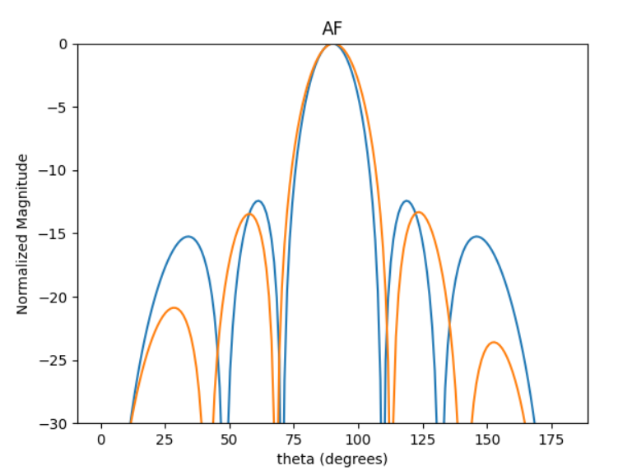
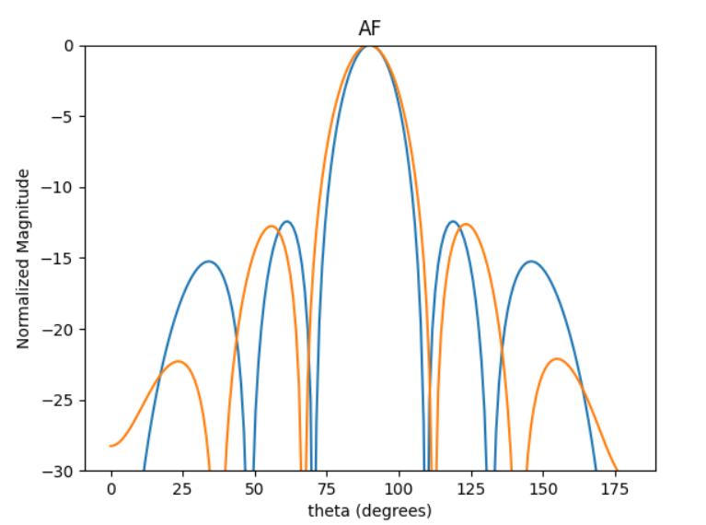
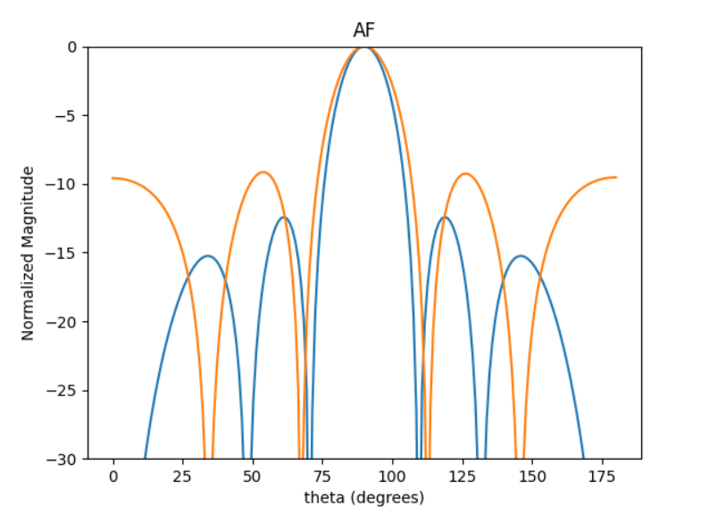
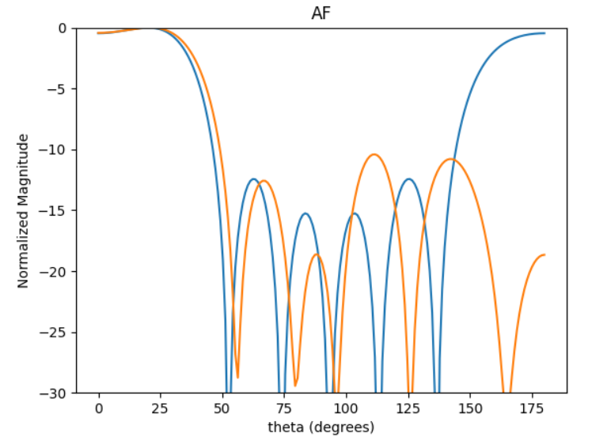
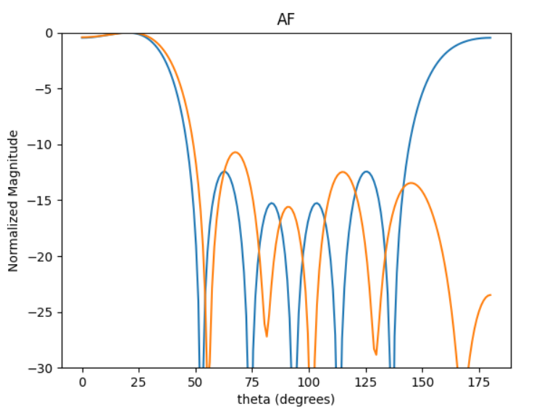
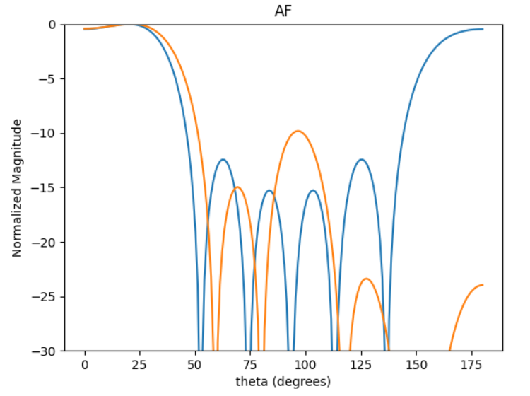
Best avg DIRR :
0.25*DIRR90deg + 0.75*DIRR20deg
BEST DIRR20deg
[0.5, 0.375, 0.5, 0.375, 0.5]
[0.475, 0.375, 0.5, 0.375, 0.475]
[0.275, 0.5, 0.425, 0.5, 0.275]

Slide 9
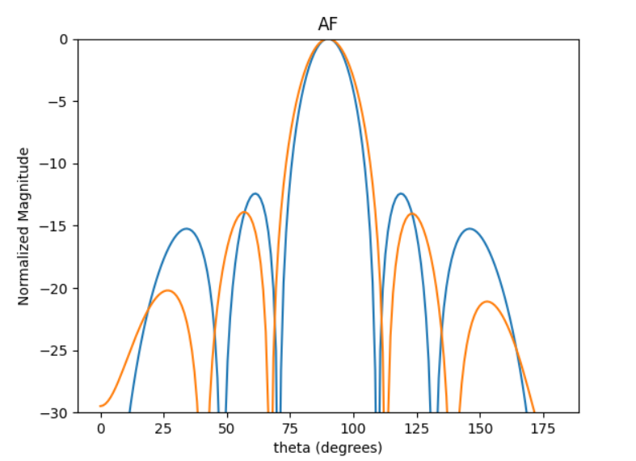
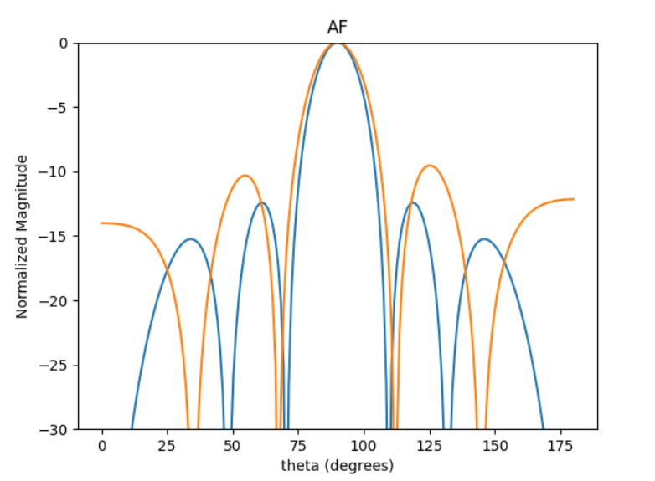
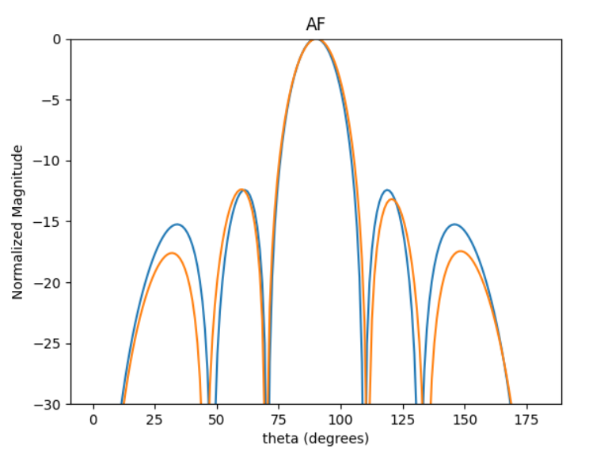
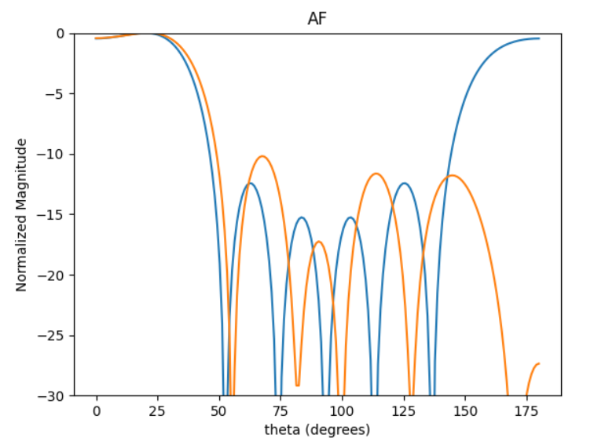
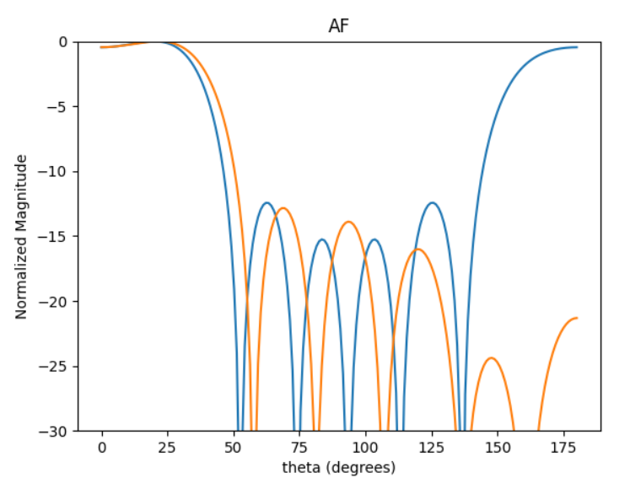
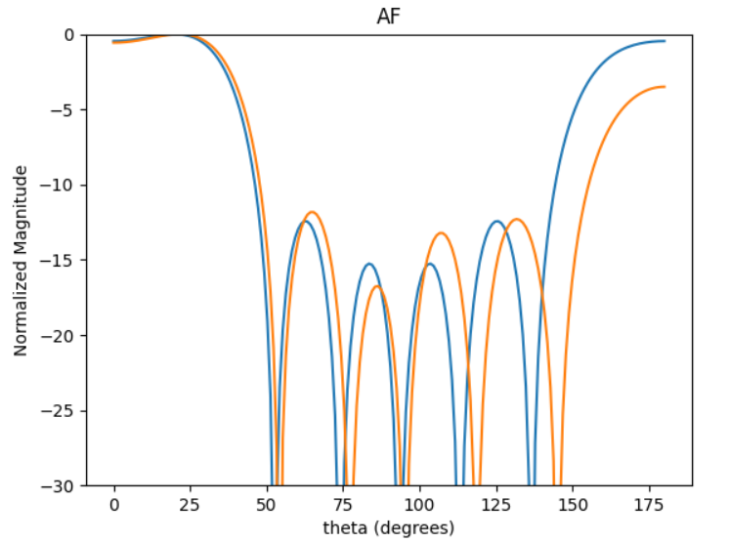
BEST SLLx2 X DIRRx2
Best SLL20deg
SLLx2 * DIRRx2 * AF[0]
[0.5, 0.375, 0.475, 0.375, 0.5]
[0.35, 0.45, 0.475, 0.45, 0.35]
[0.5, 0.45, 0.5, 0.45, 0.5]

Slide 11
[A, B, C, B, A]
[0.5, 0.5, 0.45, 0.5,0.5]
[0.5, 0.375, 0.4, 0.375, 0.5]
[0.5, 0.35, 0.5, 0.35, 0.5]
NORMALIZED
[0.5, 0.5, 0.175, 0.5, 0.5]
[0.5, 0.5, 0.5, 0.5, 0.5]
The directivity increases as the average spacing increases and crashes down when A (grey) resets. The reset value depends on how large C is.
Directivity increases as the spacing becomes larger.
Side lobe levels increase after [0.5, 0.375, 0.4, 0.375, 0.5]
As C becomes larger the values of A and B can be smaller for the solution to meet the criteria.

Slide 12
Symmetrical linear antenna array.
[0.1, 0.1, 0.1, 0.1, 0.1] - [1, 1, 1, 1, 1]
Increments of 0.025

Slide 13
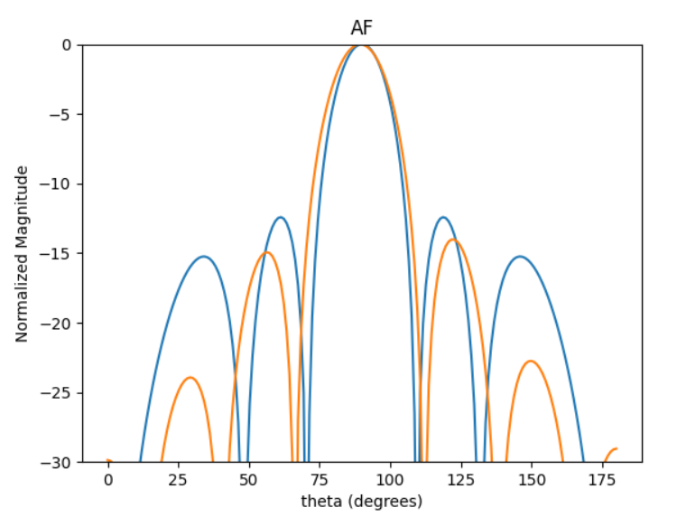
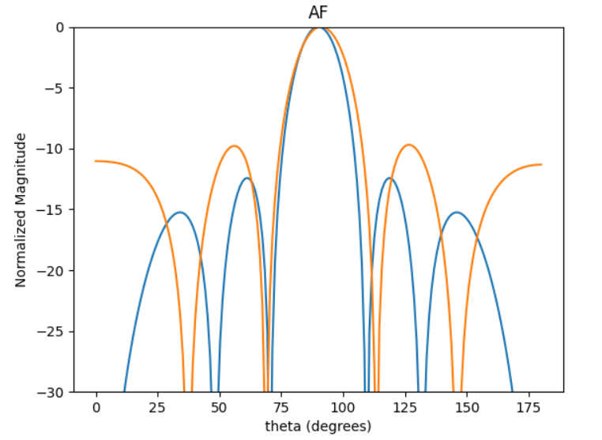
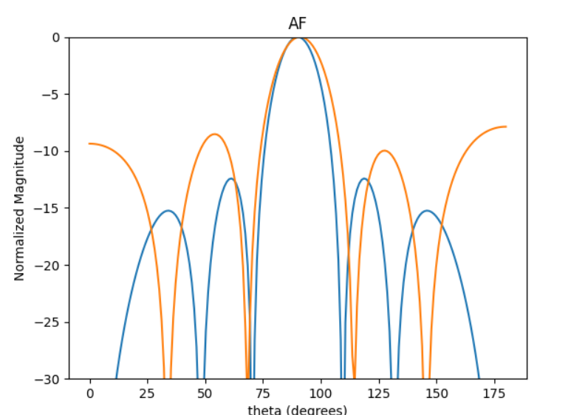
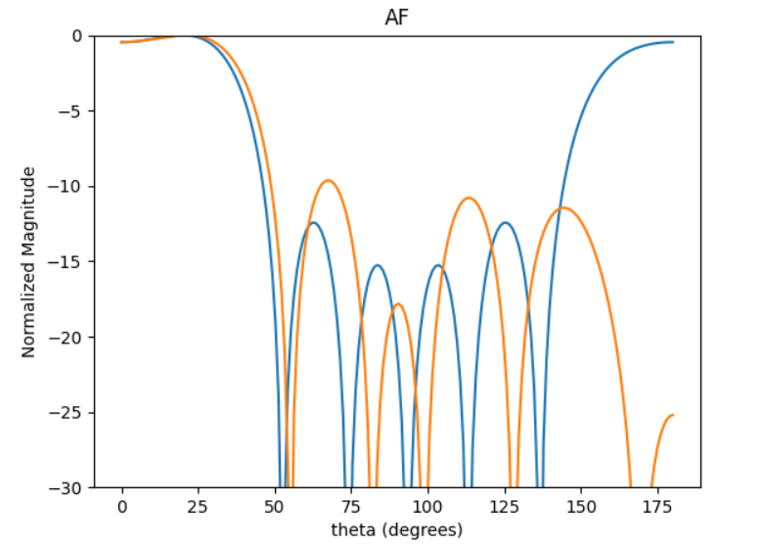
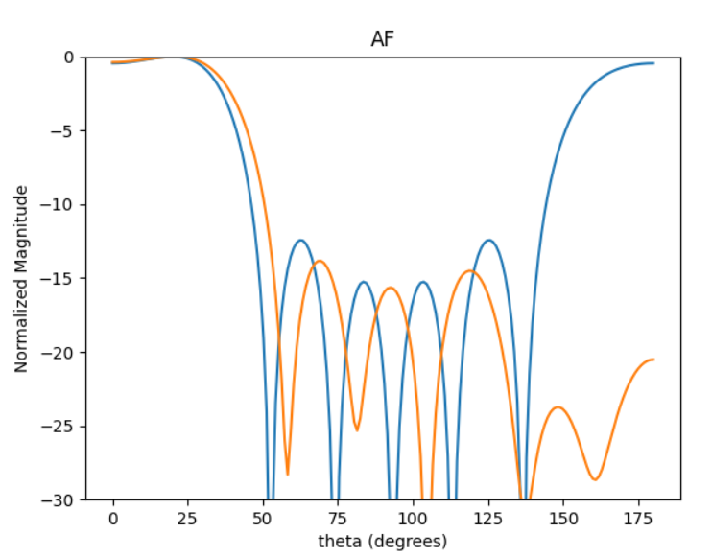
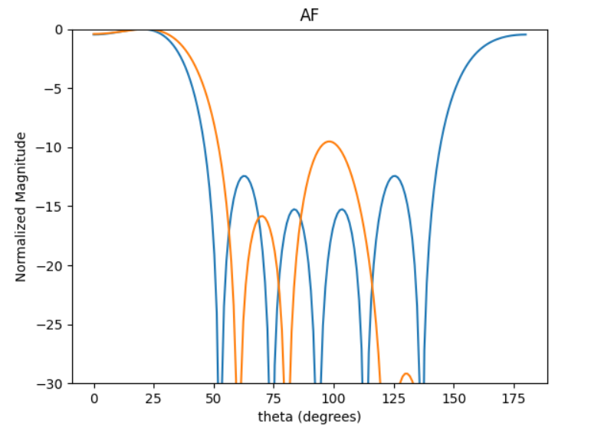
Best avg DIRR (0.5/0.5 & 0.25/0.75)& SLLDIRR:
BEST DIRR20deg
[0.525, 0.35, 0.5, 0.35, 0.525]
[0.325, 0.475, 0.45, 0.475, 0.325]
[0.25, 0.525, 0.375, 0.525, 0.25]

Slide 14
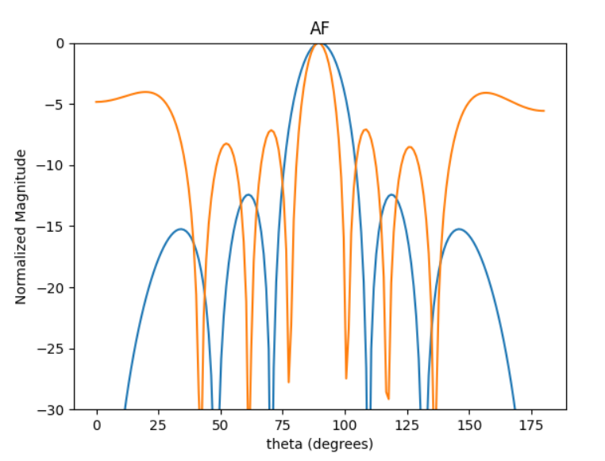
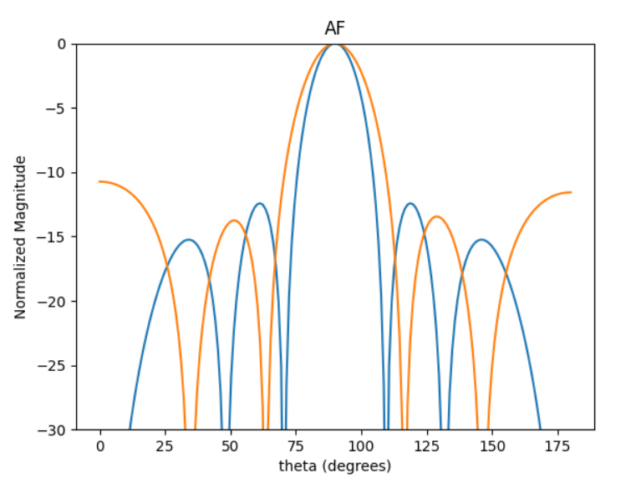
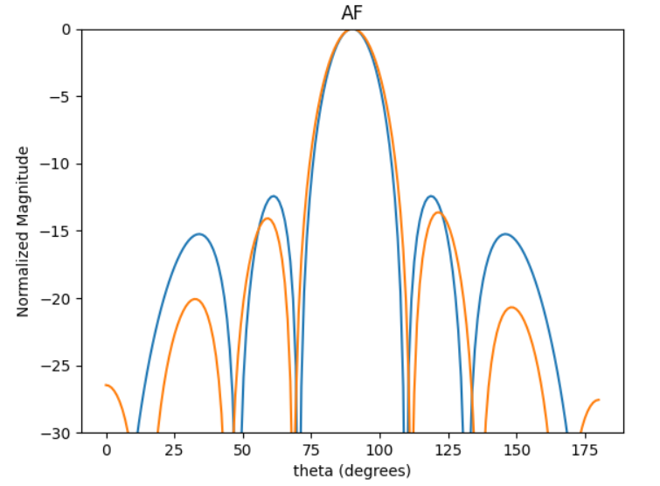
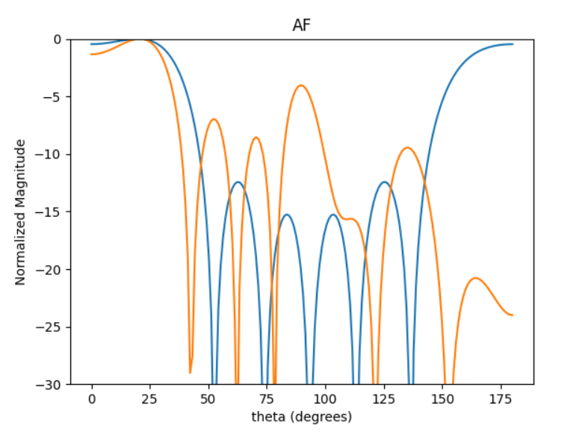
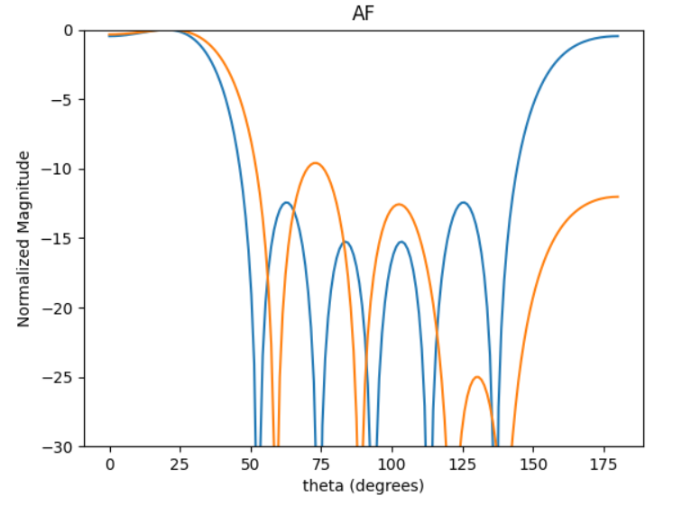
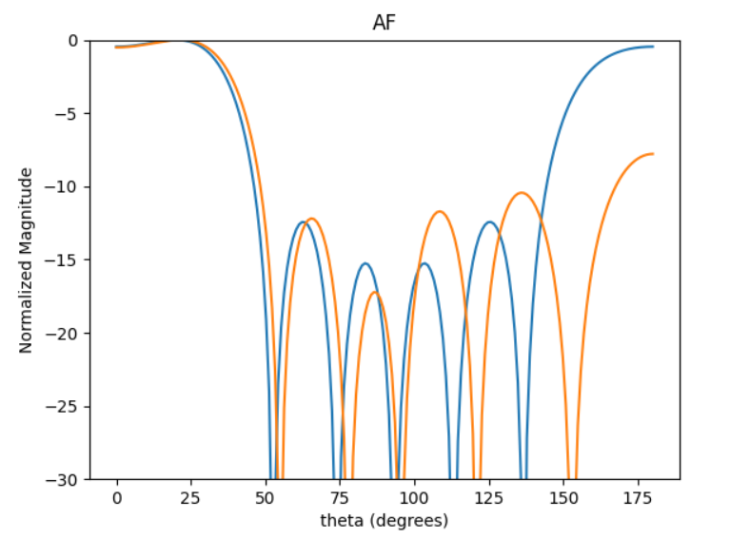
Best HPBW20DEG
Best SLL20deg
SLLx2 * DIRRx2 * AF[0]
[0.375, 0.9, 1, 0.9, 0.375]
[0.35, 0.525, 0.475, 0.525, 0.35]
[0.525, 0.4, 0.5, 0.4, 0.525]

Slide 15
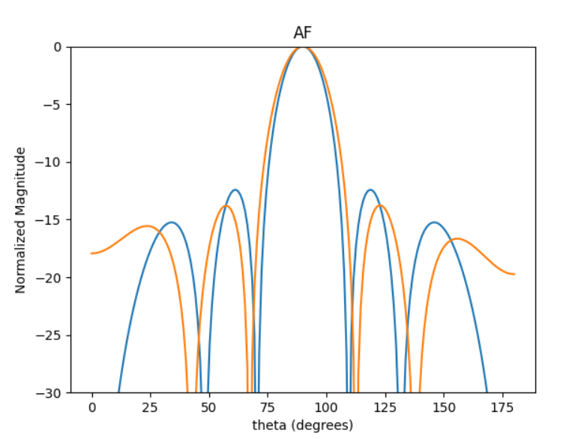
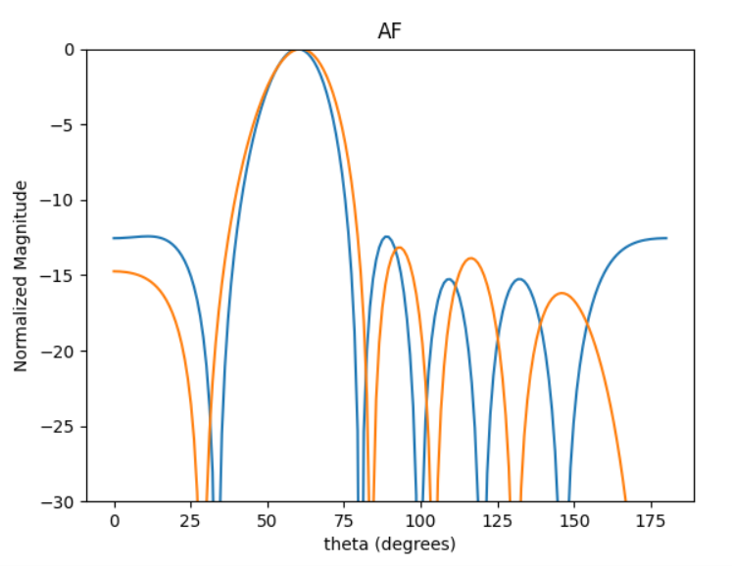
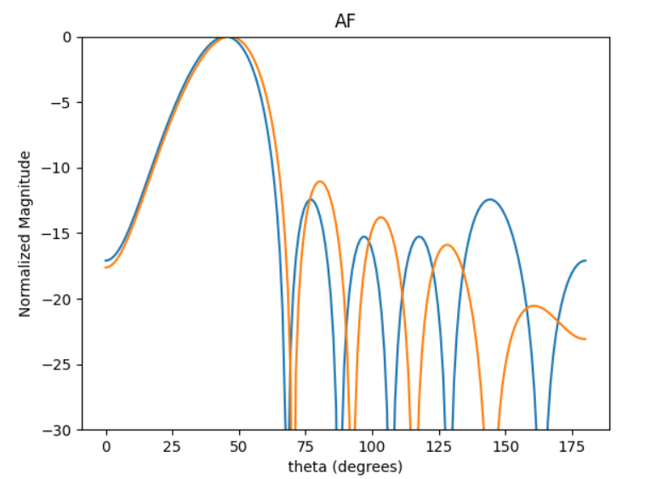
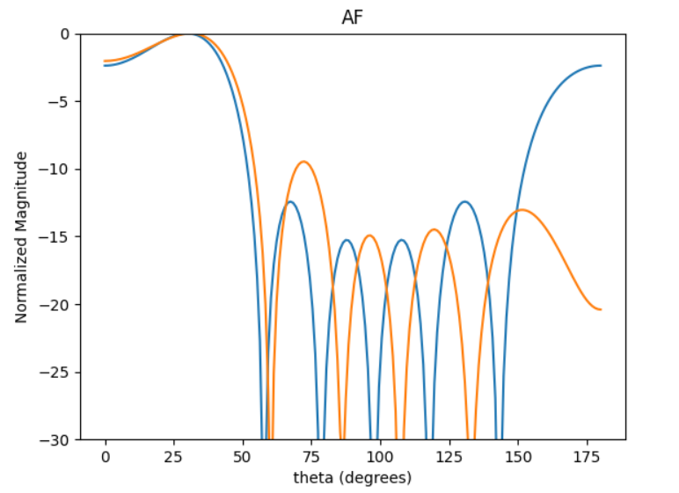
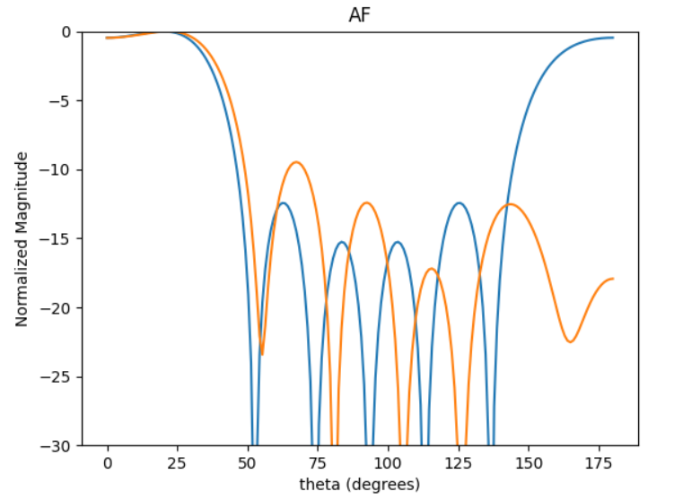
[0.425, 0.475, 0.5, 0.475, 0.425]

Slide 16
